Slide 1
Supply-chain Attacks
How one country is pwning us all, silently and effectively

Slide 2
whoami
Alberto Pelliccione – CEO @ ReaQta
https://linkedin.com/in/albertopelliccione
REAQTA
www.reaqta.com

Slide 3
Starting with a question
How to:
Compromise millions of devices
While remaining undetected
Without using a single exploit
A simple answer: Supply-chain. Or abusing the trust chain between a provider and its customers.

Slide 4
Understanding the motivations
Supply-chain attacks are a growing trend:
Highly effective strategy
Very hard to detect
Can be used for both targeted and mass attacks
3 main reasons:
Opportunistic targeting at scale
Mass targeted espionage
4th party intelligence/data collection

Slide 5
Opportunistic Targeting at Scale

Slide 6
Nice to meet you WINNTI
Winnti Umbrella
Notes:
https://401trg.com/burning-umbrella/

Slide 7
Nice to meet you WINNTI
2010 a new Threat Actor is born, later dubbed Winnti Umbrella
Mainly targets Gaming Companies
Steals digital certificates to reuse in further attacks
Steals source codes and mines in-game gold currency to monetize
2011 Valve and Gameforge are breached
35M records stolen from Valve, undisclosed from GameForge
100k+ computers of Gamers become infected with a trojan
Other 35 gaming companies worldwide are targeted by the group
The mistake: WINNTI was targeting the company but their trojan ends up being served as an update to an undisclosed “widely popular online game”
Notes:
2011 Valve: 35M records
2011 Gameforge: undisclosed
2016 Teamviewer they claim 0
2019 Infestation 10k to 100k
2018 Bayer
Asus 1M+ infections
https://threatpost.com/gamers-pointblank-backdoor-malware/144088/
https://securelist.com/winnti-more-than-just-a-game/37029/
https://threatpost.com/gamers-pointblank-backdoor-malware/144088/
https://www.reuters.com/article/us-germany-cyber/basf-siemens-henkel-roche-target-of-cyber-attacks-idUSKCN1UJ147

Slide 8
WINNTI Sudden Realization Moment
WHAT IF INSTEAD OF TARGETING THE COMPANY
WE TARGET THEIR CUSTOMERS

Slide 9
WINNTI Refocus
In 2014 WINNTI appears to refocus, what looked like a criminal gang changes strategy and aligns with different types of interests. Gaming remains an industry of interest but pharmaceuticals starts to be targeted more and more:
Bayer, BASF, Henkel, Roche are attacked by the same group
2018-2019 WINNTI keeps targeting some gaming companies
In Asia they repeat the same scheme as in 2011… 3 times
Garena, Electronics Extreme, Zepetto
Compromised games make 100k+ victims
One constant remains: the WINNTI backdoor keeps evolving over time, increasing in sophistication.

Slide 10
Putting the puzzle together

Slide 11
Mass Targeted Espionage

Slide 12
Target the masses, catch a few
Step 1) Acquire minimal information from a very large pool
Step 2) Identify key figures in key organizations
Step 3) Use the victims as a bridge for targeted attacks
Reasons
Possible lack of actionable intelligence on the intended target
More sophisticated or security-aware targets
Avoid alerting an entity that it is about to be targeted

Slide 13
Nice to meet you BARIUM
Barium Group

Slide 14
March 2017 - CCleaner
Entrypoint
Unattended workstation (TeamViewer) from one of Ccleaner’s developers
Barium installs first a VBS malware on the machine
Then they deploy ShadowPad malware
After that the supply-chain attack begins
Notes:
https://thehackernews.com/2018/04/ccleaner-malware-attack.html
https://blog.avast.com/additional-information-regarding-the-recent-ccleaner-apt-security-incident
2.27M computers infected, 40 escalated belonging to Google, Microsoft, Cisco, Intel, Samsung, Sony, HTC, Linksys, D-Link, Akamai and VMware.

Slide 15
Operation Workflow
Continuous
Integration &
QA
Digital
Signing
Deployment
Code is written and pushed

Slide 16
March 2017 - CCleaner
Targets
2.27M devices with 1st stage backdoor
40 devices with 2nd stage backdoor
Akamai, Asus, Cisco, D-Link, Fujitsu, Google, HTC, Intel, Linksys, Microsoft, Samsung, Singtel, Sony, VMWare

Slide 17
June 2018 - ShadowHammer
Barium manages to sign a modified Asus binary from 2015 with an Asus certificate
The trojan is hosted on the Asus Update Server
It remains silent if the MAC address of the victim is not recognized
Around 100.000 infections, only 600 MAC addresses targeted
Notes:
https://securelist.com/operation-shadowhammer-a-high-profile-supply-chain-attack/90380/
https://securelist.com/operation-shadowhammer/89992/
https://www.vice.com/en_us/article/pan9wn/hackers-hijacked-asus-software-updates-to-install-backdoors-on-thousands-of-computers

Slide 18
Linking the attacks

Slide 19
4th Party Collection

Slide 20
4th Party Collection
Attack those with the keys to the Kingdom
Effective against hard targets
Potentially offers a privileged access to a well defended infrastructure
Attacks are much harder to detect
Multiplication factor in effect if the targeted entity is a MSP

Slide 21
Hello APT10, welcome to the party!
APT10
MSP
Notes:
https://www.fireeye.com/current-threats/apt-groups.html
Unsophisticated, spear phishing, lnk file, targets MSP and defence

Slide 22
Apr 2017 – APT10 – Operation CloudHopper
Entrypoint
MSP via carefully crafted Spear Phishing campaigns
Targets
Aligned with China’s FYP: aerospace, new materials, robotics, next-gen IT…
MSP (Enterprise Services and Cloud Hosting) and their customers (IP theft)
High value system (for high level access) and low value (for persistence)
Remains persistent for very long time
Notes:
https://www.pwc.co.uk/cyber-security/pdf/cloud-hopper-report-final-v4.pdf

Slide 23
Operation CloudHopper Workflow
MSP
MSP Customer
Lateral Movement
via reuse of shared creds
APT10
Exfil via MSP
Data Gathering

Slide 24
September 2019 - Airbus
4 Airbus suppliers are breached
Rolls Royce (engines)
Expleo/Assystem (avionics)
2x undisclosed
Target: certification process, engines for A400M and A350

Slide 25
Enter COMAC – ARJ21
Development started: 2002
Maiden flight (planned): 2005
Maiden flight (effective): 2008
First commercial flight: 2016
Problems: avionics, wiring, wing cracks etc…

Slide 26
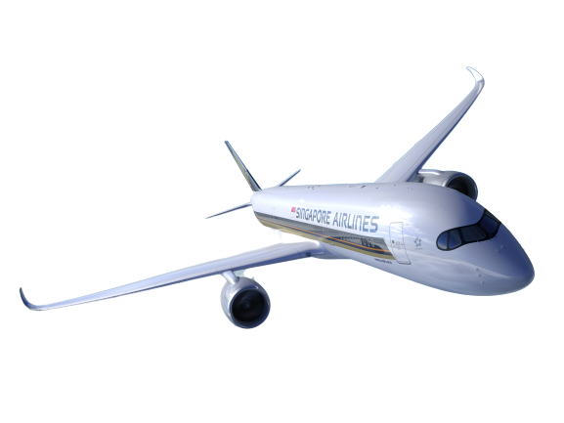
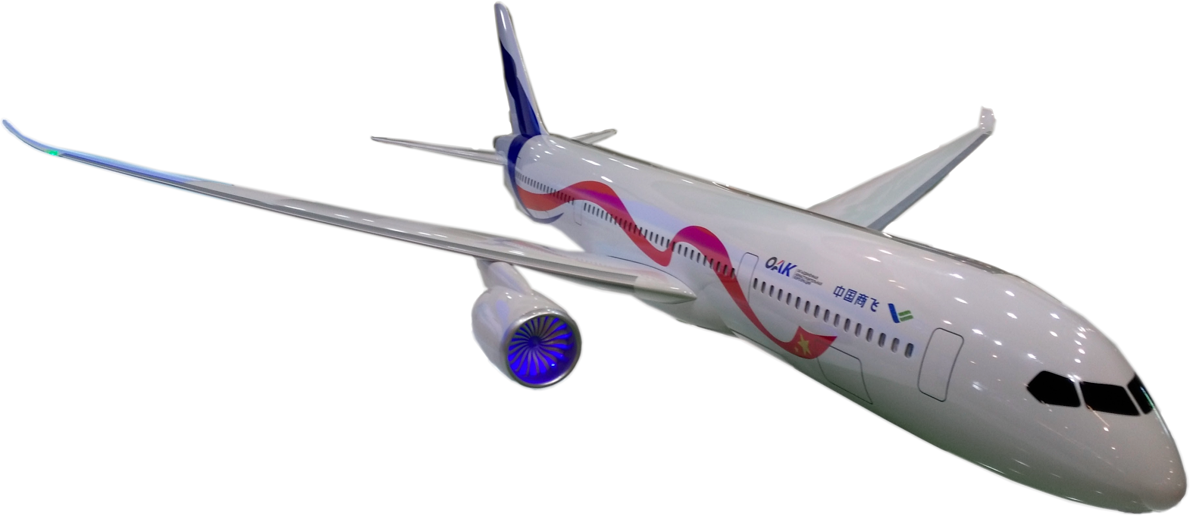
Enter COMAC – CR929
CR929
Engines: 2
Aisles: 2
Passengers: 250-290
Length: 64M
Thrust: 86000 lbf (Trent 1000?)
Range: 12000KM
A350-900
Engines: 2
Aisles: 2
Passengers: 315
Length: 66M
Thrust: 87000 lbf (Trent XWB)
Range: 15000KM

Slide 27
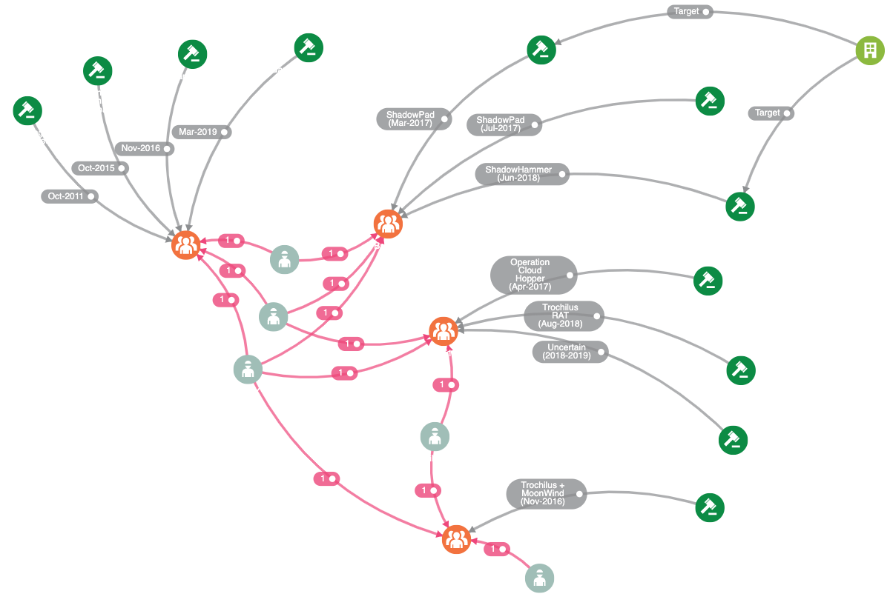
Linking the attacks

Slide 28
Increasing Sophistication

Slide 29
2019 – ICEFOG
Entrypoint
Supply-chain defence contractors
ICEFOG is shared among many groups (APT15, APT9, Roaming Tiger)
Targets
Defence, Governments, High-Tech

Slide 30
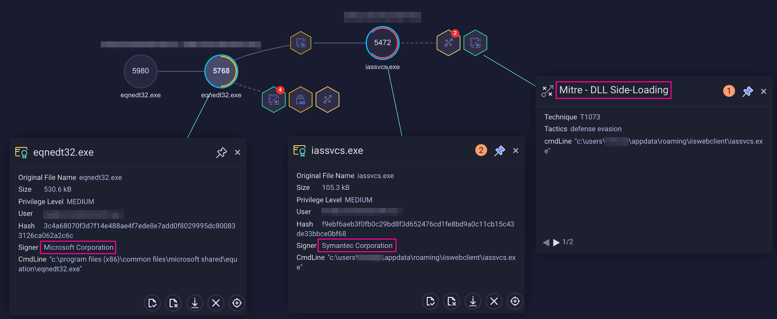
2019 – ICEFOG (file-less payload)

Slide 31
Completing the Puzzle

Slide 32
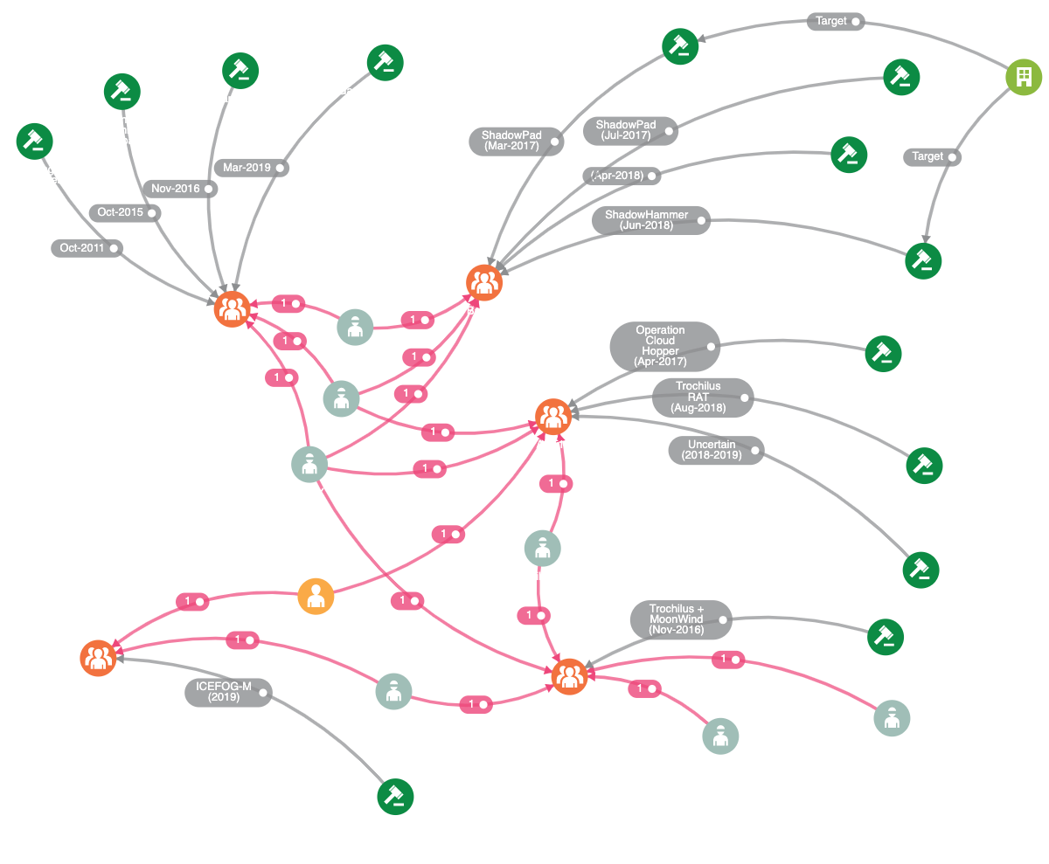
The Final Picture

Slide 33
Conclusions
Supply-chain attacks are highly effective
1) to hunt for targets
2) to get into highly secured infrastructures
Hard to detect due to trust chain between suppliers and customers
1) Network monitoring and anomaly detection do help
2) Behavioral Analysis on the endpoint is effective

