Slide 1
The only way to survive is
to automate your SOC
Roberto Sponchioni
Senior Manager, Security Engineering, DocuSign

Slide 2
AGENDA
Who am I
DocuSign
Data Breaches
SOC automation
Scenarios (Phishing / Malware)
Conclusion / Takeaways

Slide 3
WHO AM I
Italian, based in Dublin, Ireland
Senior Manager, Security Engineering @DocuSign
Former Senior Anti-Malware Engineer @Symantec
Former Security Consultant (PT/VA, Incident Response)
Contacts:
Twitter @Ptr32Void
https://www.linkedin.com/in/robertosponchioni/
Roberto.Sponchioni@docusign.com

Slide 4
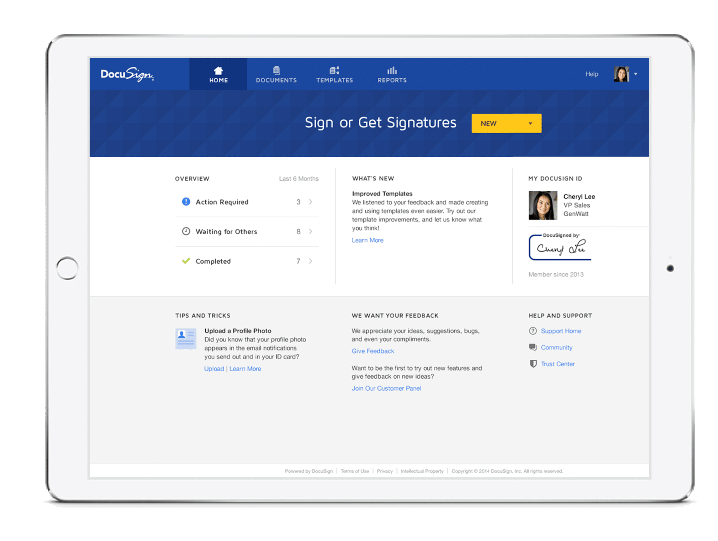
DocuSign
DocuSign digitally transforms how you do business via contracts and other types of agreements.
API Integration
Collect Payments
eSignature
SaaS

Slide 5
Main SaaS Threats / Risks
There are different threats for SaaS platforms, such as:
Phishing – DS is in the top 5 most phished brands
Fraud / Account Abuse
Availability / Downtime
Malware
Data Security
CEO Fraud / Social Engineering
Data Exfiltration
3rd Party Risk
Etc..

Slide 6
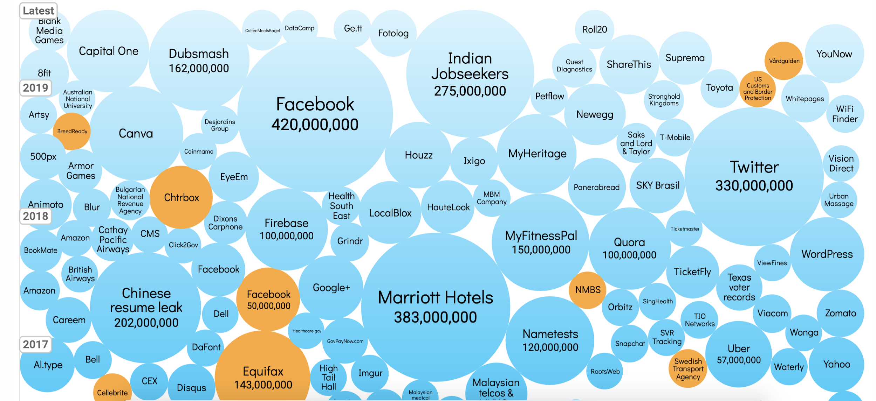
Data breaches over time
Endpoint Detection & Response Tool
Tools primarily focused on detecting and investigating suspicious activities (and traces of such) other problems on hosts/endpoints.
01
Firewall Systems
02
Firewall is a network security system that monitors and controls incoming and outgoing network traffic based on predetermined security rules.
Other Systems & Users/Employees
Asset Management, Vulnerability Management Systems, DLP, etc.
06
Email Security System
03
Email Threat Prevention Systems that helps protecting against advanced, multi-stage and multi-vector attacks.
Incident Response Tracking Tool
Incident Management, Incident Tracking. Timeline, alert that has been generated, username, user location, etc.
05
04
VPN Endpoints and Single Sign On
VPN extends the concept of private network across a public network, and enables users to send and receive data securely. SSO instead allows you to access multiple related, yet independent, software systems
https://www.informationisbeautiful.net/visualizations/worlds-biggest-data-breaches-hacks/

Slide 7
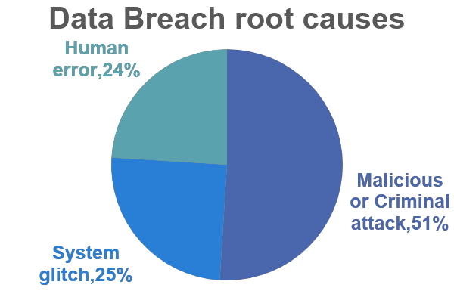
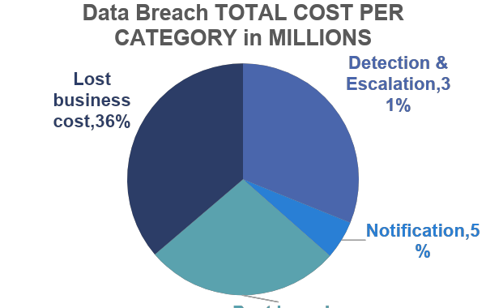
The importance of keeping your data secure
$1.22m
$1.42m
$1.07m
$0.21m
TIME TO IDENTIFY AND CONTAIN A DATA BREACH
AVERAGE TOTAL COST OF A DATA BREACH
Average cost of data breach in orgs without security automation
AVERAGE SIZE OF A DATA BREACH
279 DAYS
$3.92 M
95% higher
25,575 RECORDS
* Cost of a Data Breach Report 2019

Slide 8
Why Automating your SOC environment
Many Security Tools
Information Sharing
ML
A wider range of security suites are being adopted by Security Teams, it is more difficult to effectively monitor all of the data being generated.
Companies need to share more threat intelligence with industry peers to better defend against ever-changing threats.
ML can help, but will not solve your problems. Stay away from whoever tells you that their ML works 100% and is bullet proof.
Cybersecurity Skills Gap
Budget Constraints
Number of events
Most organizations, large or small might have budget constraints.
Companies are processing GBs/TBs of data per day.
53% of survey respondents reported a problematic shortage of cybersecurity skills at their organization*. Training, people leaving, etc.
The global cybersecurity workforce will be short by around 1.8M ppl by 2022, representing a rise of around 20 percent since 2015**.
* https://www.csoonline.com/article/3331983/the-cybersecurity-skills-shortage-is-getting-worse.html
** https://www.helpnetsecurity.com/2017/06/09/cybersecurity-workforce-gap/

Slide 9
Security Orchestration, Automation & Response Tool
Commercial & Free
Commercials:
Splunk Phantom Security Orchestration
PaloAlto Demisto
Gartner: “Market Guide for Security Orchestration, Automation and Response Solutions"
Free (a couple of examples):
Luigi - https://github.com/spotify/luigi
Huginn - https://github.com/huginn/huginn

Slide 10
Build Vs Buy
Why we made the decision to build vs buy for some of the tools we use?
Notes:
In-house development expertise
Ability to respond quickly to problems
Cost - High initial cost (eg.: 1 or 1 and ½ FTEs) but very low cost afterwards
Vendor Lock-In – switching can be difficult if there are requirements to retain the data
Sometimes when you buy a product is not Plug and Play (don’t fall into the trap of thinking that you can simply install the product and be done)
Open Source software can help sometimes
Developed software is specific for our environment and needs (Phishing, etc.)

Slide 11
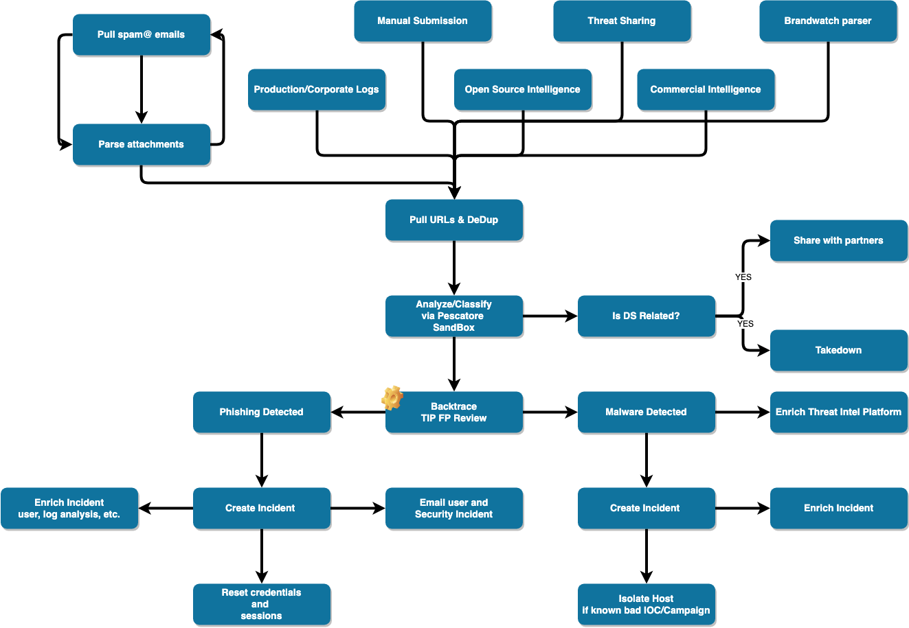
Scenario 1 – Phishing Attack
Automated Response
Hours
Minutes
Notes:
You need to:
find out which domains/URLs they visited (how do you know which one it is if you have millions of requests per day?)
find out if the domain is actually a phishing (how do you know? Screenshot? VT? SafeBrowsing? What else?)
look through the endpoint log and firewall logs (a lot of events right?)
find out if they entered credentials (check suspicious logins using logs, email him/her, etc.)
get the password and SSO session reset ASAP
block possible email access
block URL on the firewall/proxy or block the domain using an agent installed on the machine (eg.: Security Internet Gateway – DNS resolver)
take the URL down if the phishing is targeting your brand (contact ISP, etc. etc.)
have them do the security training again (engage with Security Training and Awareness department of your company)

Slide 12
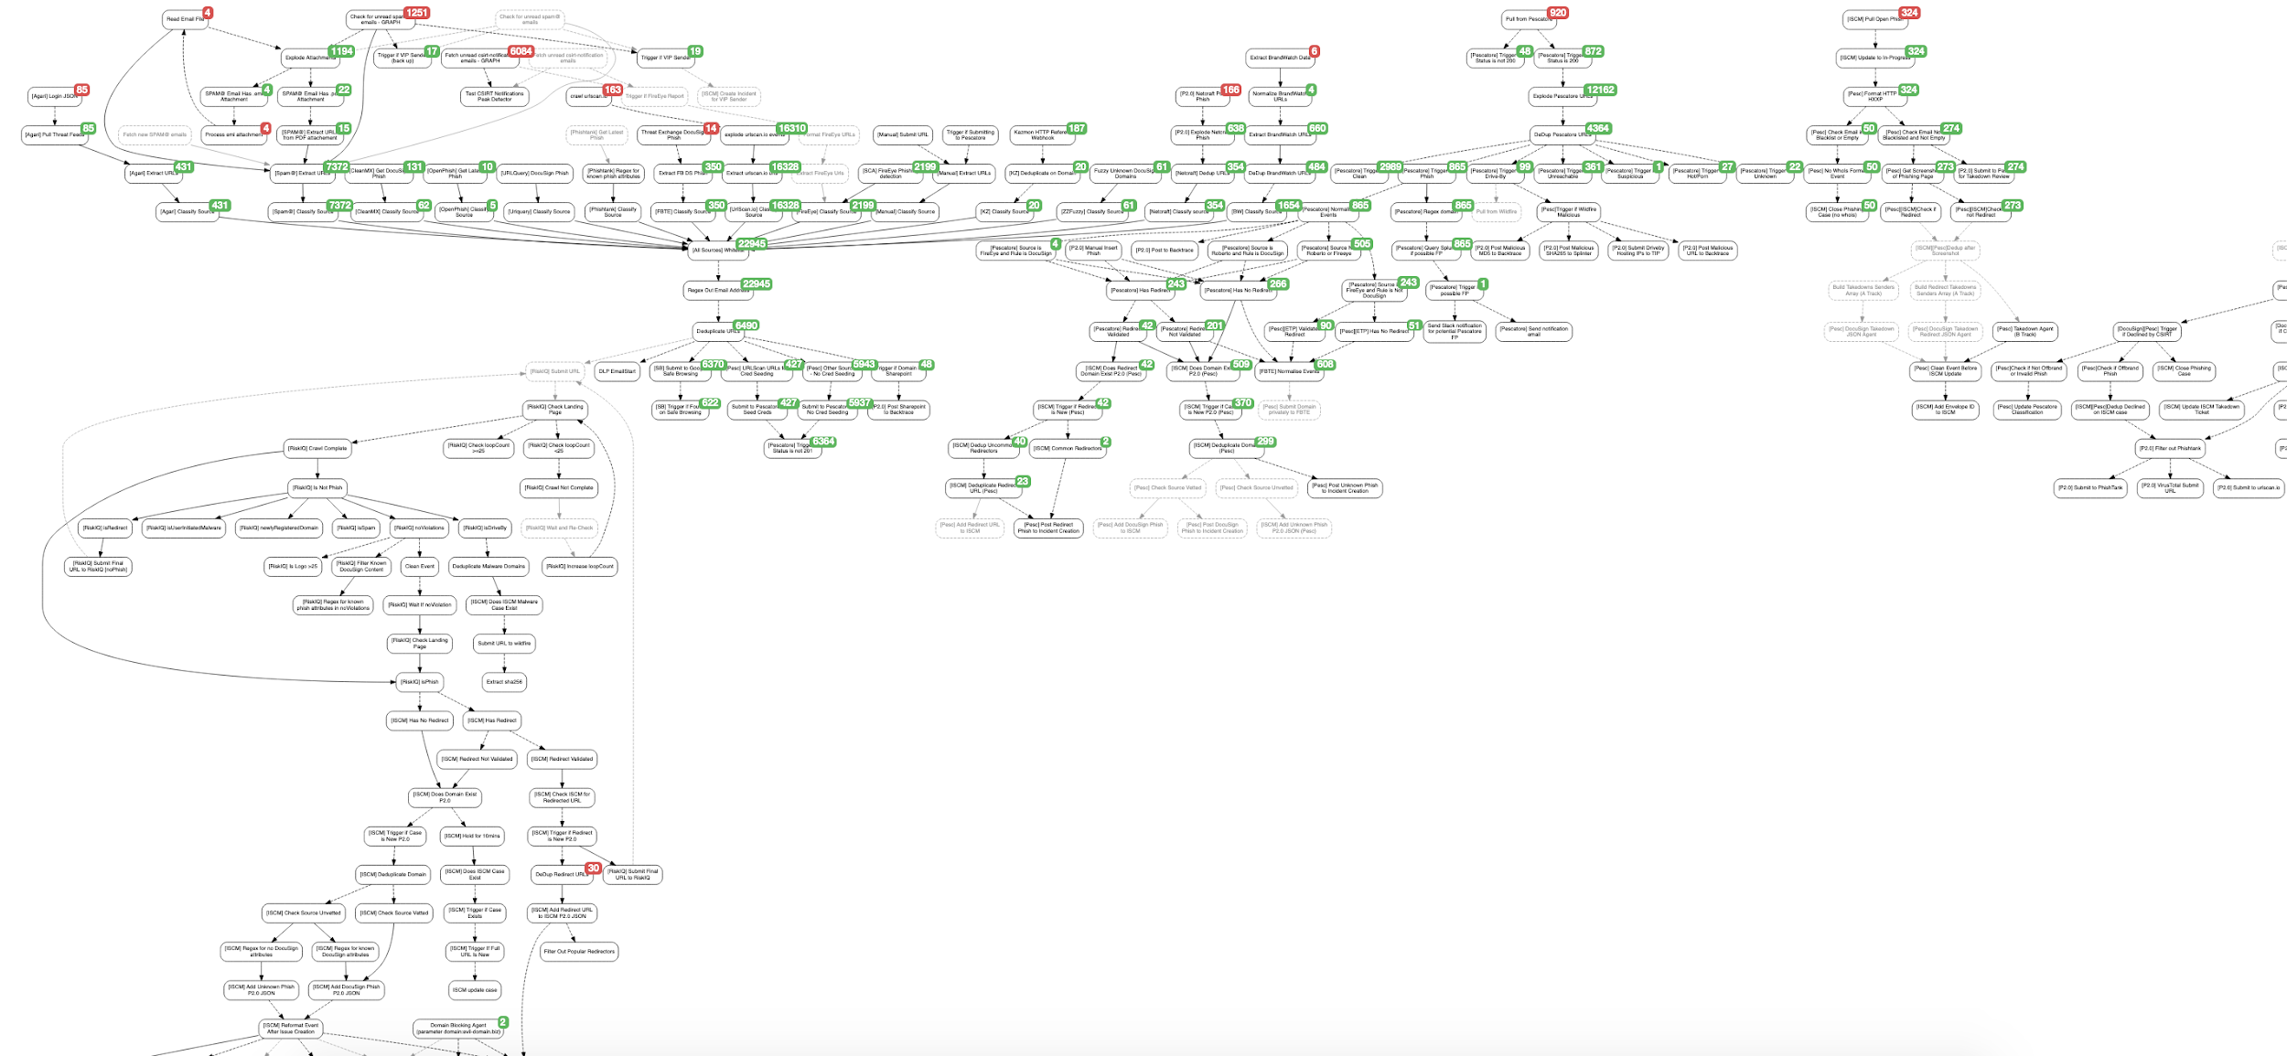
Scenario 1 – Phishing Attack
Automated Response (partial)

Slide 13
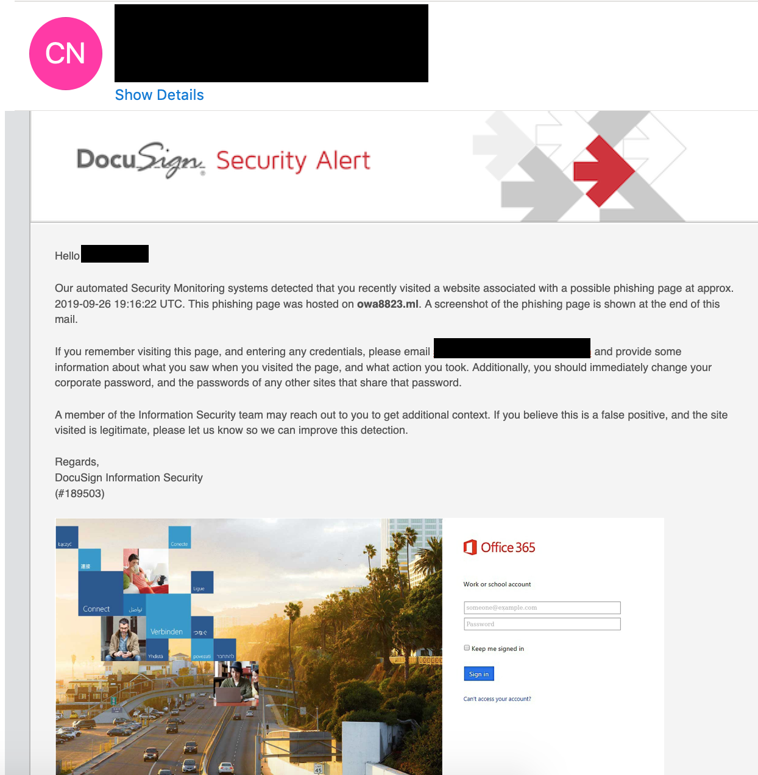
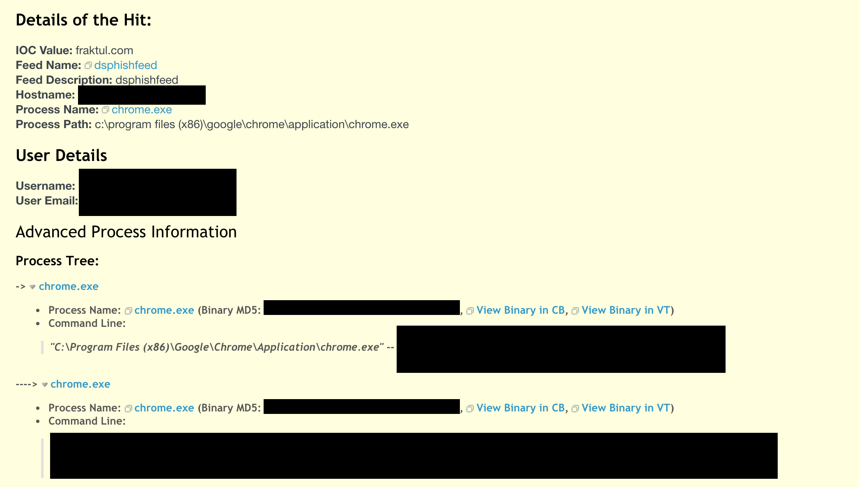
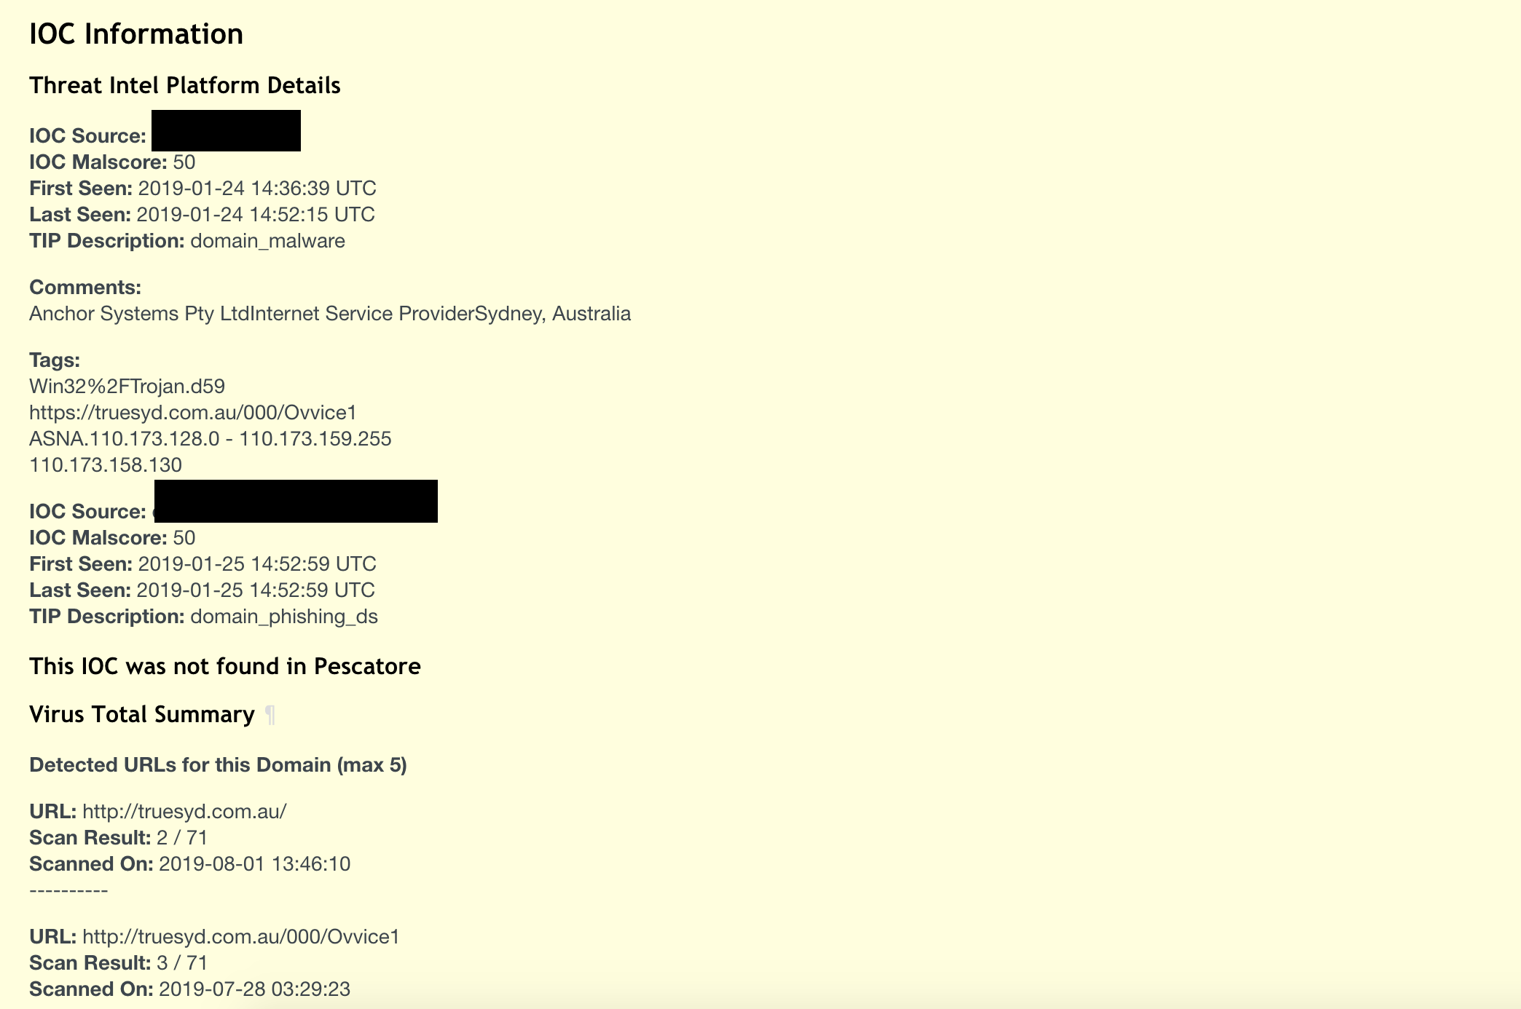
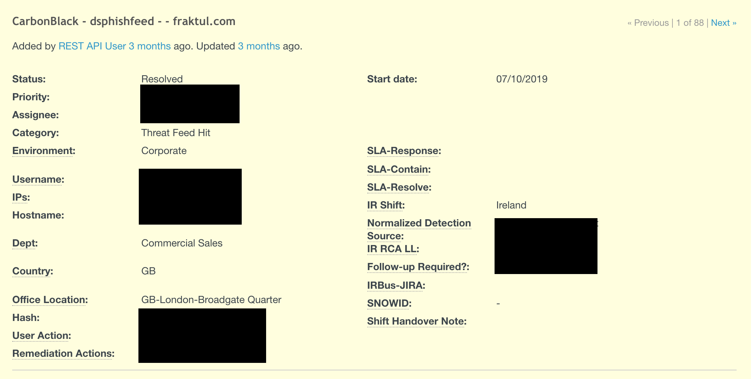
Scenario 1 – Phishing

Slide 14
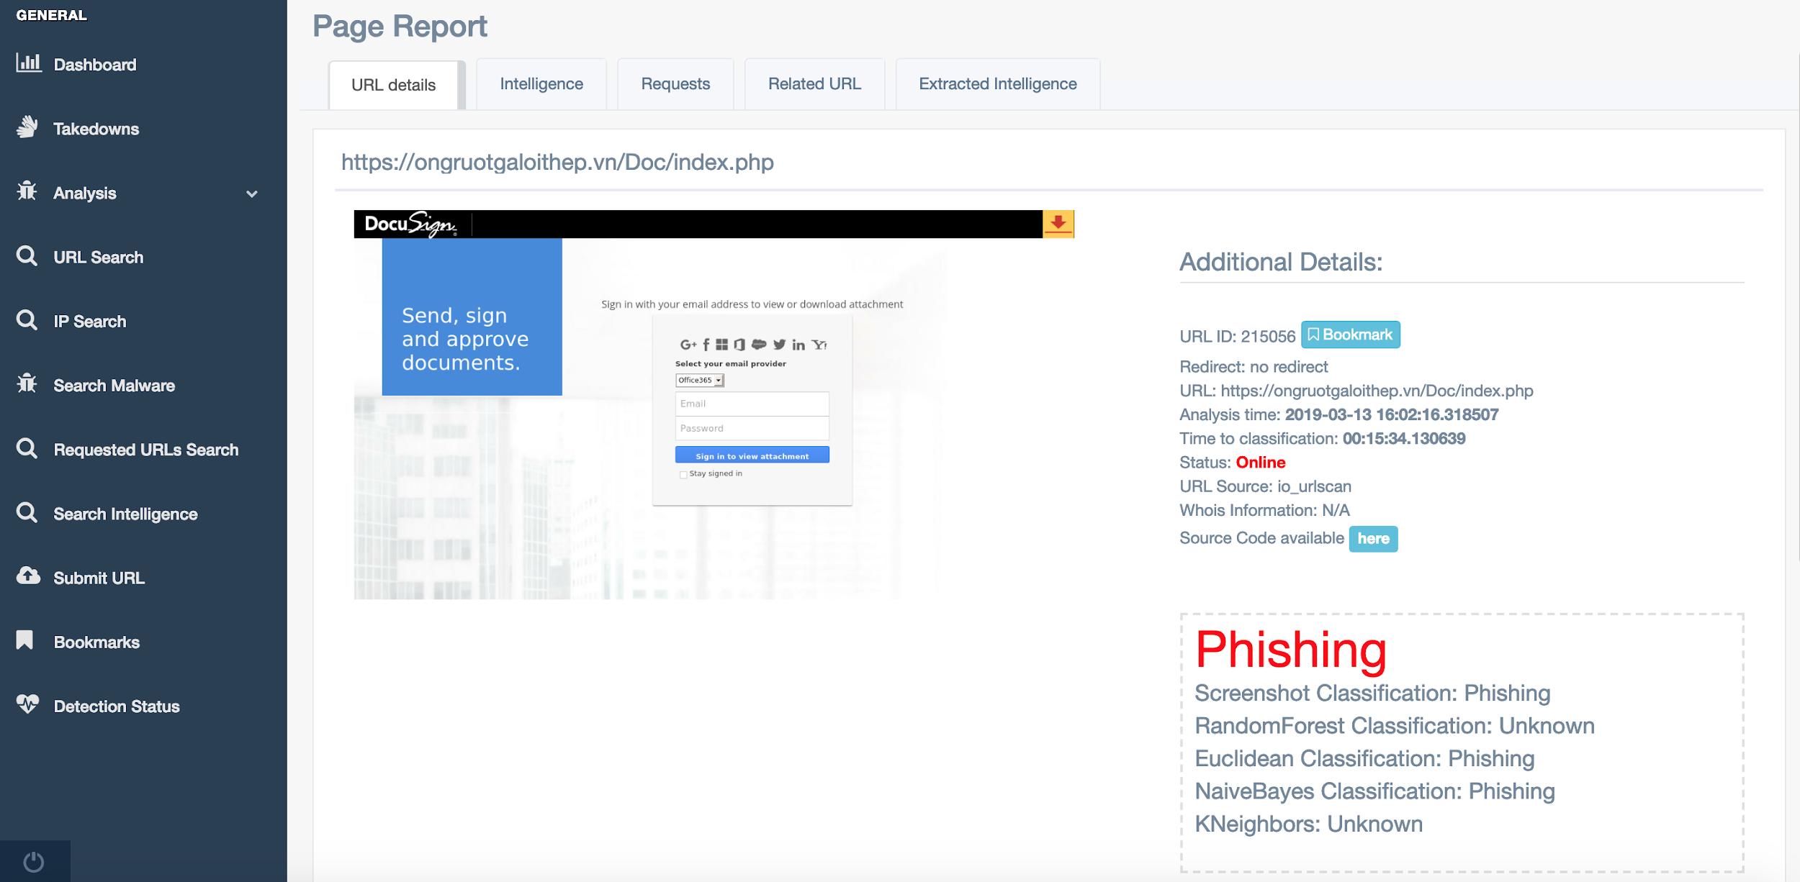
Pescatore

Slide 15
Pescatore in a nutshell..
DB Heuristic
DB Heuristic classifications can classify URLs based on extracted features; for example:
Is the URL reachable?
Does the requested page contain login forms, a password box and does the URL contains “/wp-content” or “/images”?
Etc.
Yara Rules
1
Yara rules can be used to classify URLs if Yara risk >= 100
Static Classification
7
2
Python code can be written in order to identify specific URLs that cannot be loaded using the headless browser (eg.: Exploit kits).
Naive Bayes
Naive Bayes classifier uses specific features extracted from the requests and responses that the headless browser makes
6
Bad Reputation
3
Can classify URLs based on Bad Reputation
RF, KNN, Euclidean, ScreenShot
5
4
Good Reputation
ML classification is performed using the following algorithms RandomForest, K-Nearest Neighbors, Euclidean & Screenshot
Can classify URLs based on known good domains

Slide 16
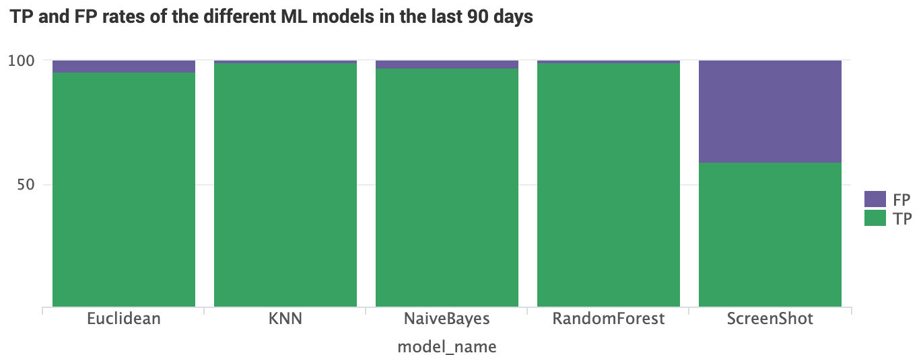
Phishing Analysis System: Pescatore - some numbers…
NUMBER OF SUSPICIOUS PROCESSED URLs PER MONTH
MACHINE LEARNING TRUE POSITIVE VS FALSE POSITIVE RATE
~ 17,000
NUMBER OF DocuSign TAKE DOWNS PER MONTH
~ 500*
* And counting…
YEARLY CLOUD PROVIDER COST
$4,000
AVERAGE TIME TO AUTOMATICALLY CLASSIFY A URL
AVERAGE TIME TO ALERT WHEN A PHISHING SITE IS HIT
AVERAGE TIME TO GET A SITE TAKEN DOWN
5/10 MINS
3 MINS
2 DAYS
COST CUT
$150k +

Slide 17
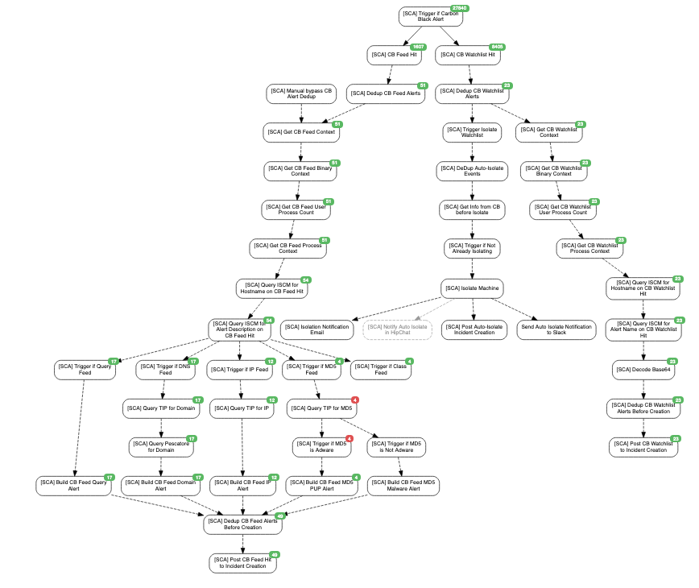
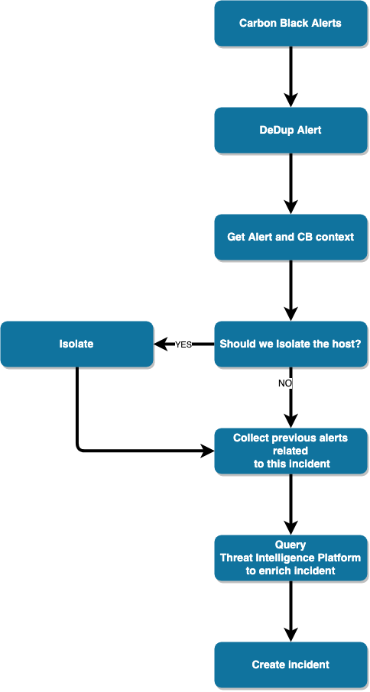
Scenario 2 – HIDS & Data Enrichment
Malicious Code or Suspicious Behavior

Slide 18
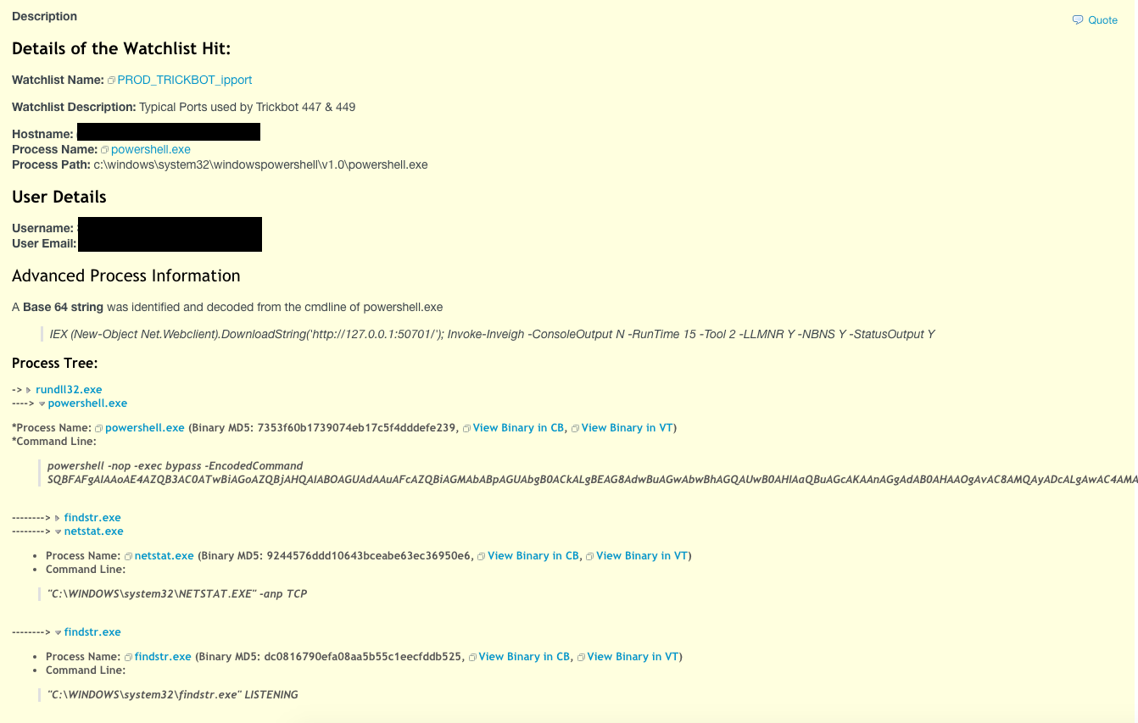
Scenario 2 – Malicious Code - Data Enrichment
Malicious Code or Suspicious Behavior
What’s in the incident?
Automated Base64 decode
Process tree with links that points to HIDS
Historical context based on alert/machine
Threat Intel Enrichment (next slide)
SOPs and Detection details (next slide)

Slide 19
Scenario 2 – Malicious Code - Data Enrichment
Malicious Code or Suspicious Behavior
Thereat Intelligence Enrichment
Where the intelligence was collected from
Malicious Score
When it was initially/last seen
VT details
Malicious URLs
Malicious downloads
Documentation is important
Type of alert
MITRE Areas (useful to identify gaps in detections or logs)
Description
Suggested Actions
False Positives

Slide 20
Conclusion / Takeaways
You want to scale, you need to automate
Do not give up
Do not be afraid to develop in-house tools
Cost saving
Do not feel you have to do everything at once, keep automating and keep developing

Slide 21
THANK YOU

